Slide 1
Inflammatory Response Flowchart ^{Arthritis and Osteoporosis}

Slide 2
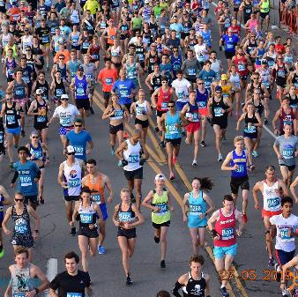
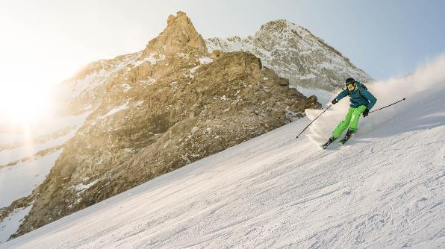
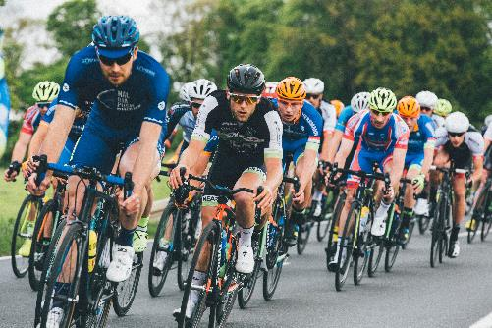
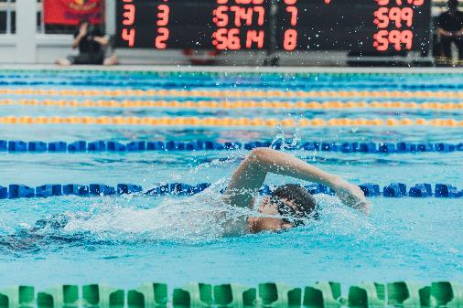
Activities and Exercise
Many of us are involved with activities that we enjoy for pleasure and maintaining health. Although these activities can provide immediate fulfillment, they can lead to both acute and chronic conditions during our lives. Recognizing injuries, proper diagnosis, treatment, recovery, as well as practicing preventive measures and managing inflammation are important steps to enjoy these activities.
Page 2

Slide 3
Inflammation and Injury
Inflammation is a defense mechanism in the body, in which the immune system recognizes damaged cells, pathogens, and abnormal conditions so that it may begin the healing process.¹
There are many different things that can cause inflammation, ranging to pathogens like bacteria, viruses or fungi; effects from chemicals or radiation; external injuries like scrapes; and in this case, internal injuries that can result from impacts or repetitive motions.² Diseases or medical conditions that cause inflammation often have a name ending with “-itis".2
Signs of inflammation vary, ranging from redness, heat, swelling, pain, or loss of function.² The body may react by feeling ill, exhausted or having a fever.² Very rare but dangerous condition is called septicemia, or blood poisoning.² Biochemically, inflammation may cause immune system cells to release various substances, known as inflammatory mediators, which include hormones bradykinin and histamine.² These hormones cause small blood vessels in the tissue to dilate, which allows more blood to reach injured tissue – and this is why inflamed areas turn red and feel hot.²
In turn, these immune systems cells are carried to the injured tissue to help with the healing process, irritate nerves and cause pain signals to be sent to the brain, which will cause us to protect that part of the body.² The mediators also make it easier for immune system cells to pass through the small blood vessels so that more can enter the affected tissue, which cause more fluid to enter the tissue – and this is what causes the swelling.²
Some inflammation don’t help the body, and some conditions cause permanent inflammation (Rheumatoid arthritis), skin disease, and inflammatory bowels.²
Page 3

Slide 4
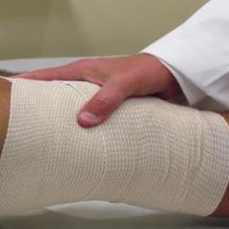
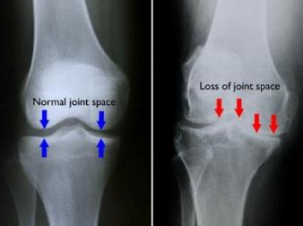
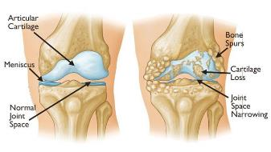
Symptoms and Diagnosis
There are similar symptoms associated with arthritis and runner’s knee, and it’s advisable to seek professional medical guidance for distinguishing and treating conditions properly.
Osteoarthritis is the most common form of arthritis and affects millions of people worldwide.³ This condition occurs when the protective cartilage that cushions the ends of your bones wears down over time, with most disorders occurring in the hands, knees, hips and spine.³ The first step is to recognize that there is a problem (often caused by inflammation) and appropriately diagnose it.
In osteoarthritis, the cartilage in the knee joint gradually wears away becoming frayed and rough, the protective space between the bones decrease, resulting in bone rubbing against bone, producing painful bone spurs.⁴
Symptoms of arthritis include:
Stiff and swollen (inflamed) joints, making it difficult to bend and straighten the knee
Pain and swelling worsening in the morning, after sitting or resting
Vigorous activity causing flare ups
Loose fragments of cartilage and other tissue interfering with the smooth motion of joints, causing locking, sticking, creaking, clicking, snapping, or grinding noise during movement
Pain may cause feeling of weakness or buckling in the knee
Increased joint pain in rainy weather⁴
Imaging tests such as x-rays, magnetic resonance imaging (MRI) scan, computed tomography (CT) scan, or a bone scan can determine the condition of the bone and soft tissues of the knee.4 Blood tests can determine which type of arthritis you have.⁴
Page 4

Slide 5
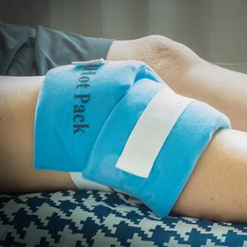
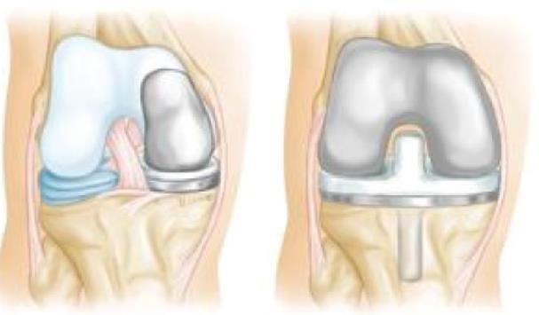
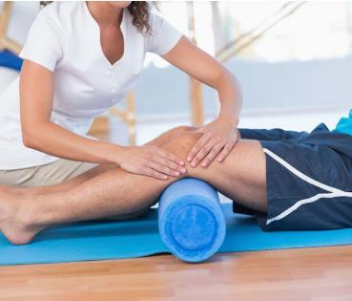
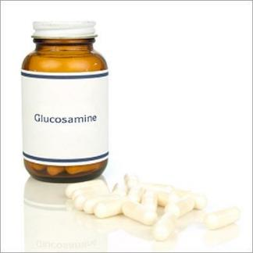
Treatment
There is no cure for arthritis, but a number of treatments that may help relieve the pain and disability it can cause.⁴
Nonsurgical treatments include lifestyle modifications, physical therapy, assistive devices, medications (anti-inflammatory and NSAID), corticosteroids, disease-modifying anti-rheumatic drugs (DMARDs), viscosupplementation, and taking supplements such as glucosamine and chondroitin sulfate (although not backed by evidence to decrease or reverse the progression of arthritis).⁴
Alternative treatments include acupuncture and magnetic pulse therapy.
Surgical treatments includes arthroscopy, cartilage grafting, synovectomy, osteotomy, total or partial knee replacement (arthroplasty).⁴
Page 5

Slide 6

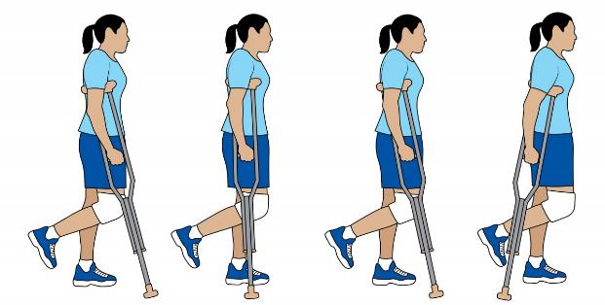
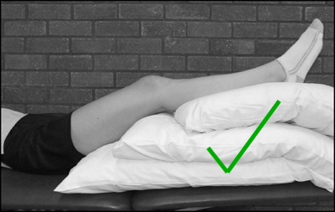
Recovery
There is no cure for arthritis, but a number of treatments that may help relieve the pain and disability it can cause.⁴
Following surgery, recovery and rehabilitation can vary, ranging from physical therapy to regain strength and restoring range of motion, knee braces, using crutches or a cane.⁴
The memory device PRICE stands for Protect, Rest, Ice, Compression, and Elevation, which can help control inflammation, but should not be used as an alternative to professional medical guidance.⁵
Page 6

Slide 7
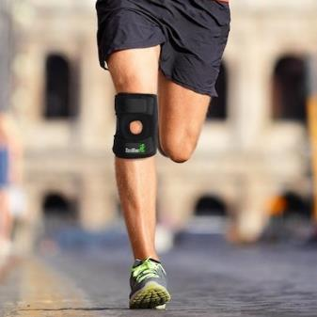
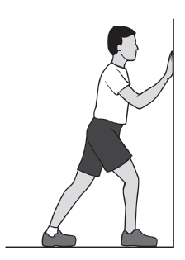
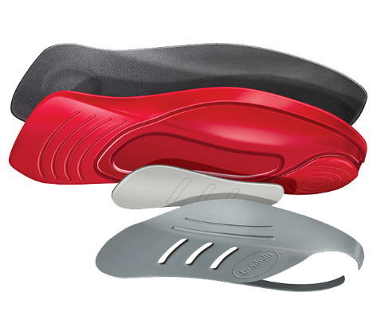
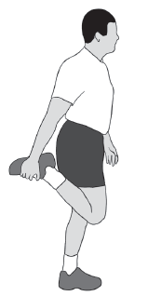
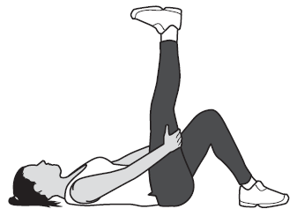
Management and Prevention
There are many methods to prevent knee pain, as well as techniques to follow after a recovering from a serious injury, which include:⁵
Maintaining a healthy body weight
Staying limber-stretching and maintaining balance
Strengthening exercises for the quadriceps
Exercising wisely – choosing alternative means of exercise, including biking, swimming, while limiting impact sports
Wear proper protection – compression bandages or knee braces
Wearing proper shoes and insoles to reduce impact or balance the feet
Page 7

Slide 8
References:
1. Justin Choi, M. (2019). Inflammation: Causes, symptoms, and treatment. [online] Medical News Today. Retrieved from: https://www.medicalnewstoday.com/articles/248423.php.
2. National Center for Biotechnology Information. (2019). What is an inflammation? [online] Ncbi.nlm.nih.gov. Retrieved from: https://www.ncbi.nlm.nih.gov/books/NBK279298/.
3. Mayo Clinic. (2019). Osteoarthritis - Symptoms and causes. [online] Retrieved from: https://www.mayoclinic.org/diseases-conditions/osteoarthritis/symptoms-causes/syc-20351925.
4. Orthoinfo.aaos.org. (2019). Arthritis of the Knee - OrthoInfo - AAOS. [online] Retrieved from: https://orthoinfo.aaos.org/en/diseases--conditions/.
5. WebMD. (2019). An Overview of Knee Pain. [online] Retrieved from: https://www.webmd.com/pain-management/knee-pain/knee-pain-overvie].
Page 8

Slide 9
Image Credits:
Page 1: (Clockwise, from top left)
OrangeTheory, Ice Break Consulting (2019). Starting Race. [image] Retrieved from: https://bb10k.bolderboulder.com/photos/.
EyeEm, Getty (2019). Knee Pain. [image] Retrieved from: https://www.verywellfit.com/knee-pain-when-running-4134724.
activewrap.com (2019). Knee bandage. [image] Retrieved from: https://activewrap.com/blogs/news/how-to-wrap-a-knee.
Pain Doctor (2019). Running with Knee Brace. [image] Retrieved from: https://paindoctor.com/best-knee-braces-for-arthritis/.
active.com (2019). Knee Ice Pack. [image] Retrieved from: https://www.active.com/running/articles/dos-and-don-ts-for-icing-injuries.
Page 2: (bottom left to right)
De Meyer, W. (2019). Hintertux Glacier, Austria. [image] Retrieved from: https://unsplash.com/photos/E7EUYeN-IyY.
Spiske, M. (2019). Bicycling. [image] Retrieved from: https://unsplash.com/photos/WUehAgqO5hE.
Yan, G. (2019). Swimming. [image] Retrieved from: https://unsplash.com/photos/tqkbzYfIhCI.
Page 4:
OrthoInfo (2019). X-ray Knee Joint. [image] Retrieved from: http://orthoinfo.aaos.org/en/diseases--conditions/arthritis-of-the-knee.
OrthoInfo (2019). Knee Joint Diagram. [image] Retrieved from: http://orthoinfo.aaos.org/en/diseases--conditions/arthritis-of-the-knee.
Page 5: (bottom left to right)
Physical Therapy & Sports Medicine Institute (2019). Physical Therapy Knee. [image] Retrieved from: https://ace-pt.org/ace-physical-therapy-and-sports-medicine-institute-treatment-of-non-traumatic-knee-pain/.
everydayhealth.com (2019). Glucosamine pills. [image] Retrieved from: https://www.everydayhealth.com/arthritis-pictures/8-supplements-for-arthritis-pain.aspx#glucosamine.
Page 6: (top left, bottom left to right)
Giang, V. (2019). Relax Hammock. [image] Retrieved from: https://unsplash.com/photos/Hcmgz1OQa_I.
ACL Injury Recovery & Rehabilitation (2019). ACL Surgery Crutches. [image] Retrieved from: https://www.aclinjuryrecovery.com/after-acl-surgery-when-can-i-walk/walking-with-crutches-after-an-acl-injury/.
Page 7: (bottom left to right)
Dr. Schools (2019). Shoe Insole Diagram. [image] Retrieved from: https://www.drscholls.com/products/pain-relief/custom-fit-orthotic-inserts/.
OrthoInfo (2019). Knee Conditioning Diagrams. [image] Retrieved from: http://orthoinfo.aaos.org/en/diseases--conditions/arthritis-of-the-knee.
Page 9

